Slide 1
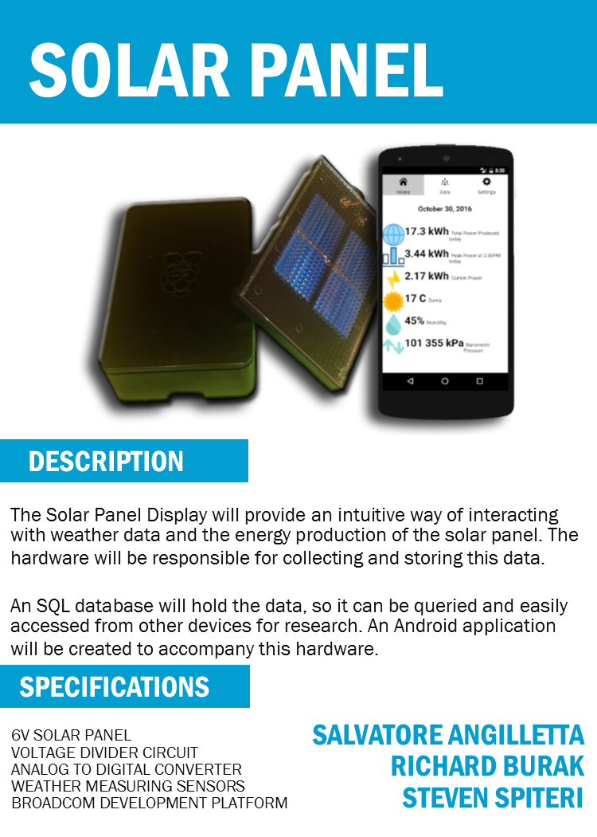
Solar Panel
Project
Salvatore’s Presentation
https://roflwaffle18.github.io

Slide 2
Project Proposal
“The problem solved by this project is how to monitor a solar panel system. The purposed hardware and mobile application will allow a user to see the power output history, system status and weather data of a solar panel system from an interactive display or from a user friendly mobile application.”
Salvatore’s Project Proposal Document (2016)

Slide 3
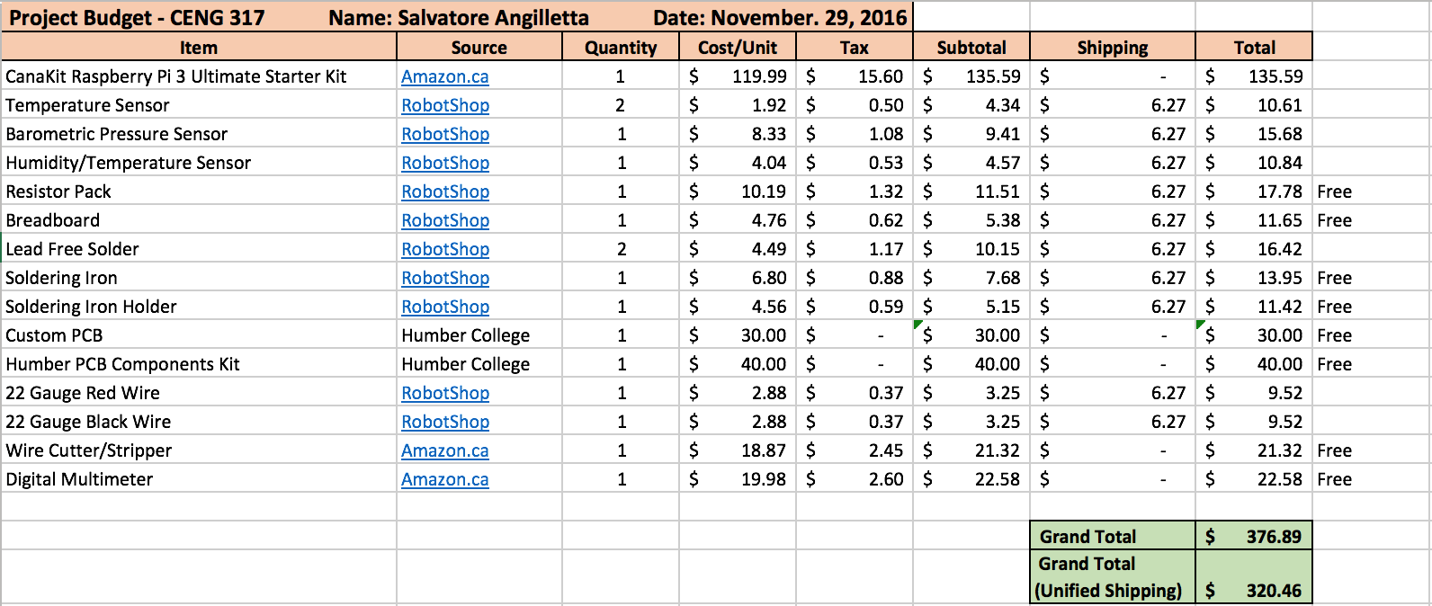
Budget
Anything that is labeled as “Free”, I used the school’s or my own resources

Slide 4
Project Schedule
Week 13 - Presentations (Being completed)
Week 14 - 15:
All we have left to do is laser cut our project box and do the finishing touches and with two weeks to finish
We are on track to finish before the end of the semester

Slide 5
Build Video
https://roflwaffle18.github.io - Video is in Week 9 posting

Slide 6
Previous Course Knowledge
TECH 101 & 150 - Electric Circuits & Electronic Devices and Circuits
CENG 215 - Digital and Interface Systems
TECH 104 - Programming Fundamentals
CENG 251 - Unix Internals
CENG 253 - Networking Technologies
WRIT 220 - Technical Workplace and Writing Skills

Slide 7
Thanks for listening

